Slide 1

Introduction to Big Data and Data Mining Oleksandr Krakovetskyi CEO of DevRain Solutions, PhD Microsoft Regional Director, Microsoft MVP http://devrain.com alex.krakovetskiy@devrain.com @msugvnua

Slide 2
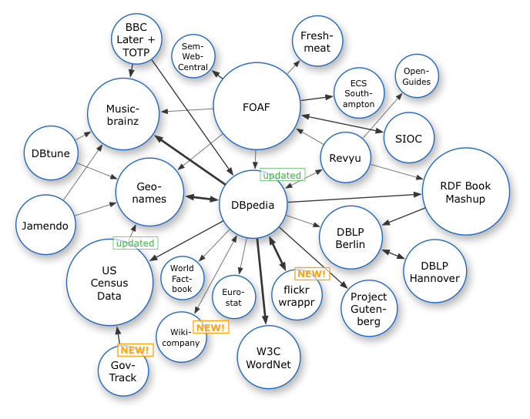
The world of data
Open data (+ governmental data).
Semantic Web (Dbpedia, Crunchbase, IEEE, IMDB).
Historical data (currencies, Forex, temperature).
Enterprise data.
User behavior.
Transactions.
Social media.
Sensor data (smart city, home, traffic).

Slide 3
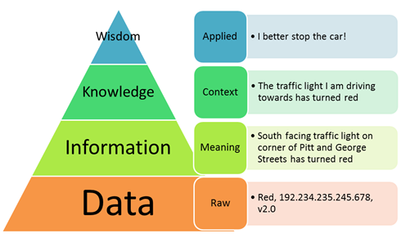
Levels of information
Raw data
Information
Knowledge
Wisdom

Slide 4
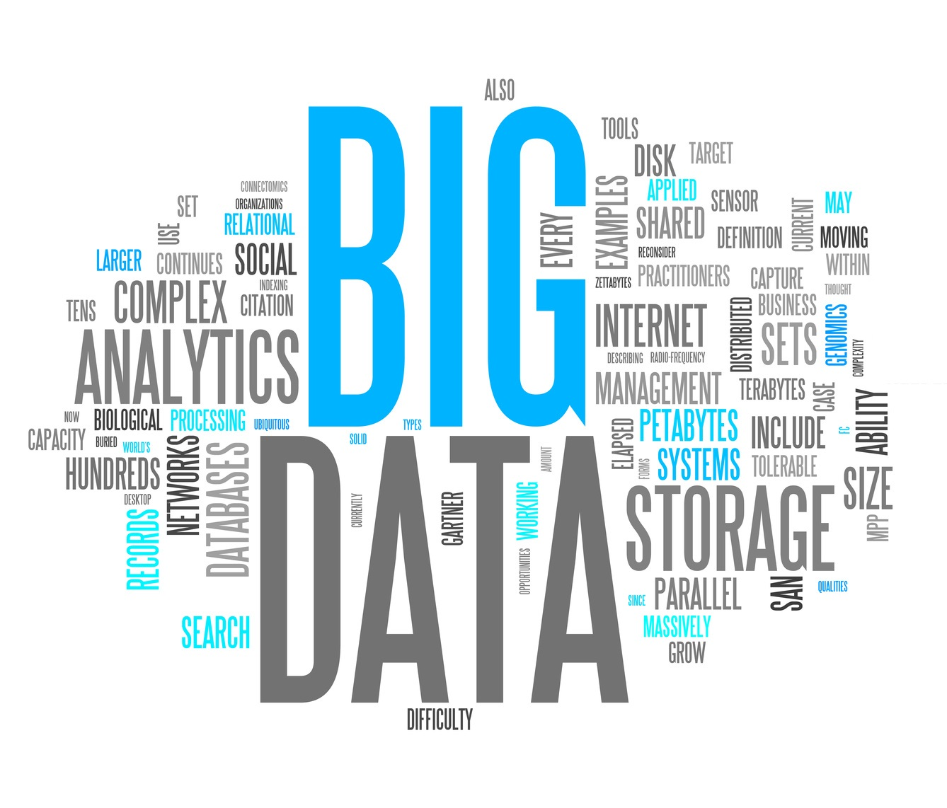
Big Data
Collecting and storing terabytes of data.
Internet of Things.
Cloud technologies.
Information security.
Data analysis (Data Mining).
Data visualization.

Slide 5
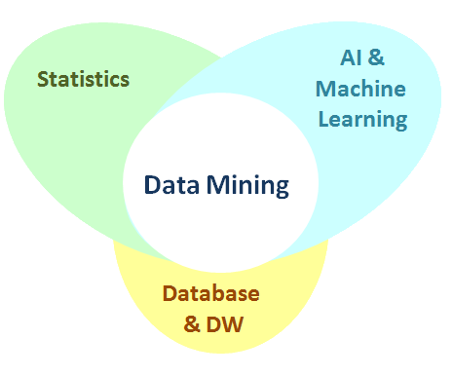
Data Mining (Knowledge Discovery) The computational process of discovering patterns in large data sets involving methods at the intersection of artificial intelligence, machine learning, statistics, and database systems. The overall goal of the data mining process is to extract information from a data set and transform it into an understandable structure for further use.

Slide 6
Tasks
Anomaly detection (Outlier/change/deviation detection) – The identification of unusual data records, that might be interesting or data errors that require further investigation.
Association rule learning (Dependency modeling) – Searches for relationships between variables. For example a supermarket might gather data on customer purchasing habits. Using association rule learning, the supermarket can determine which products are frequently bought together and use this information for marketing purposes. This is sometimes referred to as market basket analysis.
Clustering – is the task of discovering groups and structures in the data that are in some way or another "similar", without using known structures in the data.
Classification – is the task of generalizing known structure to apply to new data. For example, an e-mail program might attempt to classify an e-mail as "legitimate" or as "spam".
Regression – attempts to find a function which models the data with the least error.
Summarization – providing a more compact representation of the data set, including visualization and report generation.

Slide 7
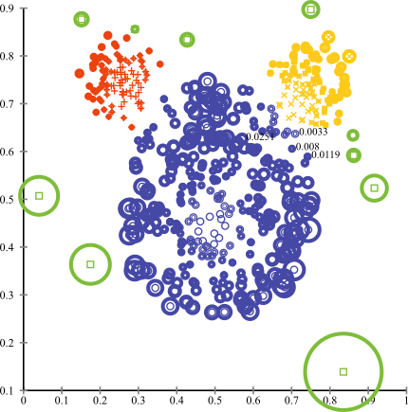
Anomaly detection
In data mining, anomaly detection (also outlier detection) is the identification of items, events or observations which do not conform to an expected pattern or other items in a dataset.

Slide 8
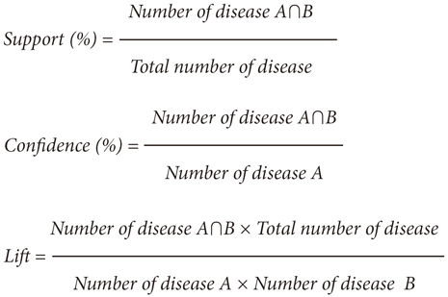
Association rules (basket analysis)
Association rule learning is a popular and well researched method for discovering interesting relations between variables in large databases. It is intended to identify strong rules discovered in databases using different measures of interestingness.
{ milk, bread, butter } has support 1/5=0.2
{ butter, bread } => { milk } = 0.2/0.2 = 1
100% of the transactions containing butter and bread the rule is correct or 100% of the times a customer buys butter and bread, milk is bought as well.
transaction ID | milk | bread | butter | beer
1 | 1 | 1 | 0 | 0
2 | 0 | 0 | 1 | 0
3 | 0 | 0 | 0 | 1
4 | 1 | 1 | 1 | 0
5 | 0 | 1 | 0 | 0

Slide 9
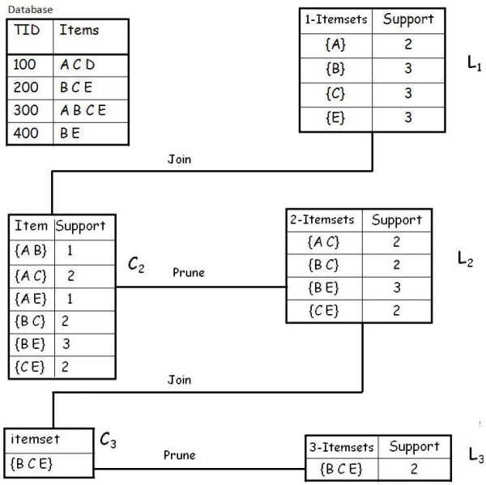
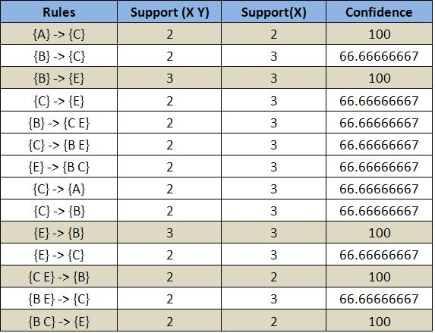
Apriori
Frequent itemsets:
{A}, {B}, {C}, {E}
{A C}, {B C}, {B E}, {C E}
{B C E}

Slide 10
Association rules
Rules with support and confidence > 60% are not knowledge.
Rules with support and confidence < 3% may be anomalies.
Knowledge rules are between 5% and 10%.

Slide 11
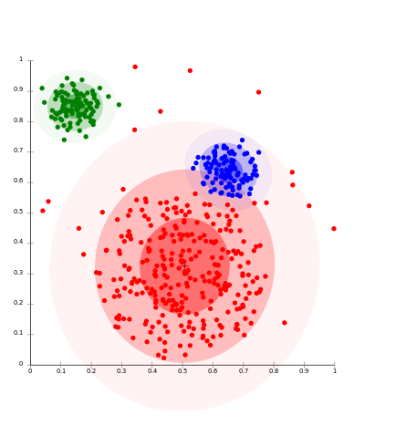
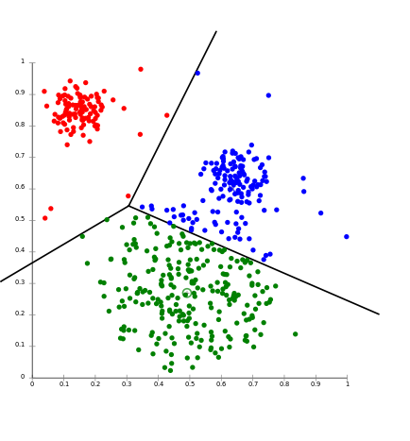
Clustering
Cluster analysis or clustering is the task of grouping a set of objects in such a way that objects in the same group (called a cluster) are more similar (in some sense or another) to each other than to those in other groups (clusters). It is a main task of exploratory data mining, and a common technique for statistical data analysis, used in many fields, including machine learning, pattern recognition, image analysis, information retrieval, and bioinformatics.
Types:
Connectivity based clustering (hierarchical clustering)
Centroid-based clustering
Distribution-based clustering
Density-based clustering

Slide 12
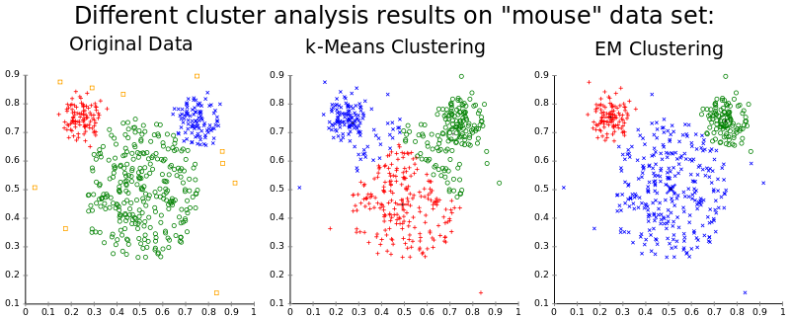
Clustering
Main criterion: distance between objects.
Methods:
K-means (depends on number of clusters, distance measure and centroids);
C-means (“fuzzy” clustering).
Iris flow data set
(http://en.wikipedia.org/wiki/Iris_flower_data_set)

Slide 13
Classification
Classification is the problem of identifying to which of a set of categories (sub-populations) a new observation belongs, on the basis of a training set of data containing observations (or instances) whose category membership is known.
Fisher's linear discriminant
Logistic regression
Naive Bayes classifier
Perceptron
Support vector machines
Quadratic classifiers
k-nearest neighbor
Boosting (meta-algorithm)
Random forests
Neural networks
Gene Expression Programming
Bayesian networks
Hidden Markov models
Learning vector quantization

Slide 14
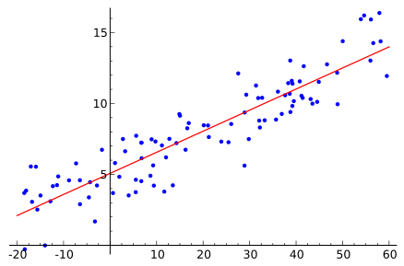
Regression
In statistics, regression analysis is a statistical process for estimating the relationships among variables.
Regression analysis
Neural networks

Slide 15
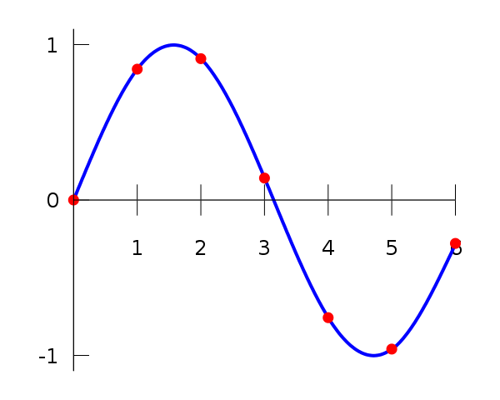
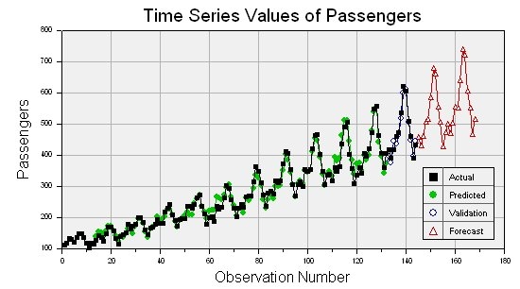
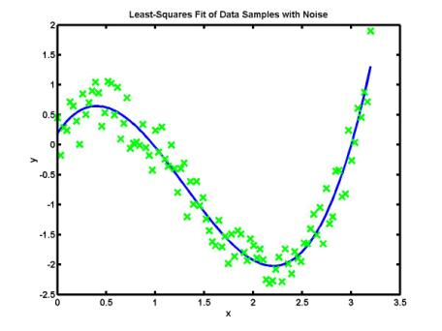
Regression
Interpolation
Approximation
Extrapolation (time series)

Slide 16
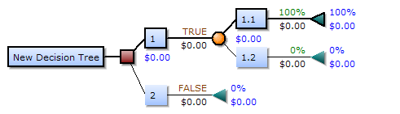
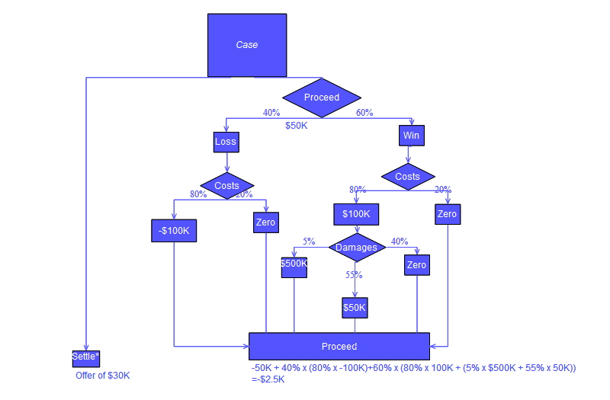
Decision trees
Uses a decision tree as a predictive model which maps observations about an item to conclusions about the item's target value.

Slide 17
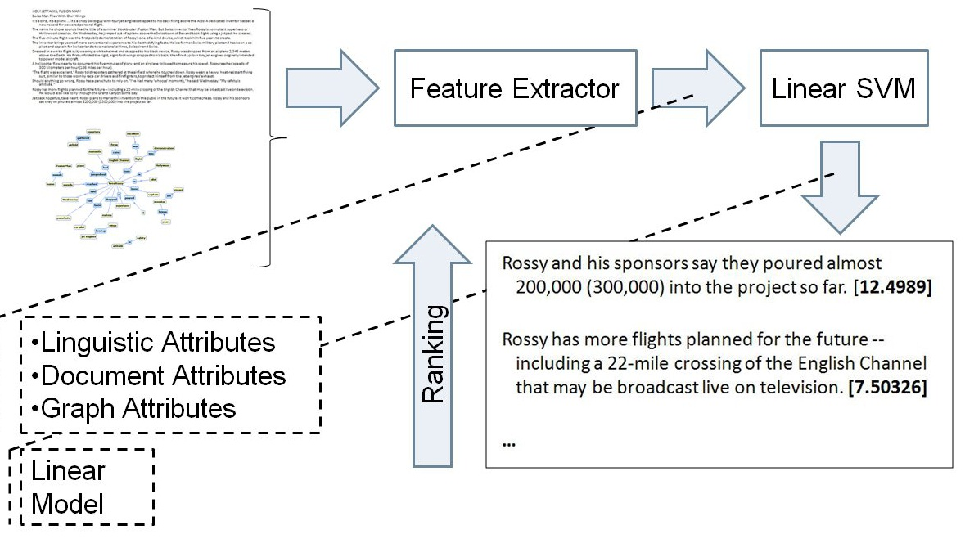
Summarization
Automatic summarization is the process of reducing a text document with a computer program in order to create a summary that retains the most important points of the original document.

Slide 18
Natural language processing
Natural language processing (NLP) is a field of computer science, artificial intelligence, and linguistics concerned with the interactions between computers and human (natural) languages. As such, NLP is related to the area of human–computer interaction. Many challenges in NLP involve natural language understanding, that is, enabling computers to derive meaning from human or natural language input, and others involve natural language generation.
Tasks:
Automatic summarization
Named Entity Recognition (NER)
Machine translations
Parsing
Question answering

Slide 19
Named Entity Recognition (NER)
Named-entity recognition (NER) (also known as entity identification and entity extraction) is a subtask of information extraction that seeks to locate and classify atomic elements in text into predefined categories such as the names of persons, organizations, locations, expressions of times, quantities, monetary values, percentages, etc.
Jim bought 300 shares of Acme Corp. in 2006.
<ENAMEX TYPE="PERSON">Jim</ENAMEX>bought<NUMEX TYPE="QUANTITY">300</NUMEX>shares of<ENAMEX TYPE="ORGANIZATION">Acme Corp.</ENAMEX> in <TIMEX TYPE="DATE">2006</TIMEX>.

Slide 20
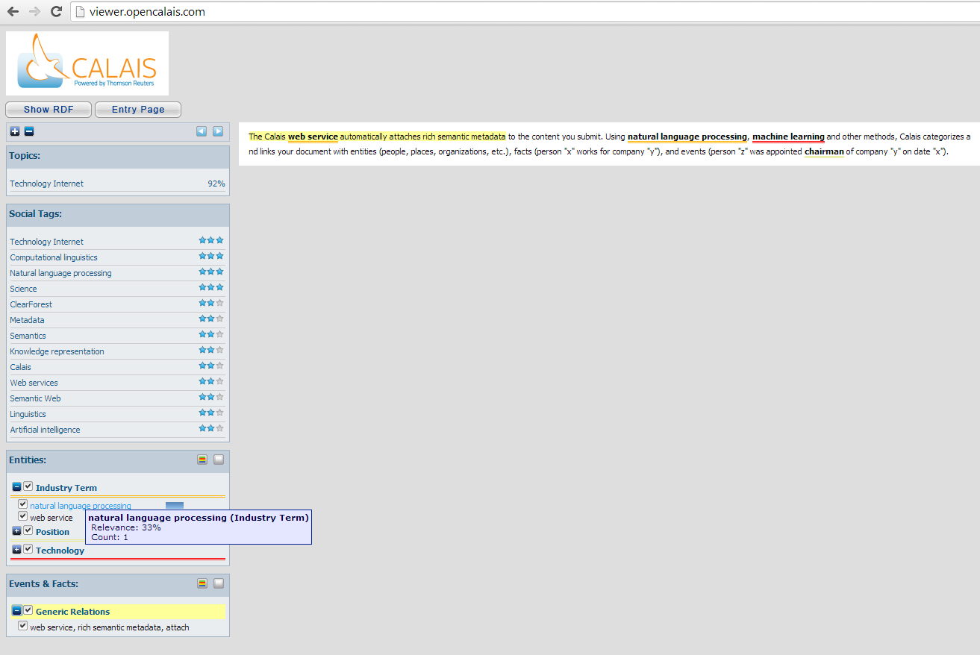
OpenCalais + DBpedia Spotlight
Calais is a toolkit of capabilities that allow you to readily incorporate state-of-the-art semantic functionality within your blog, content management system, website or application.
https://github.com/dbpedia-spotlight/dbpedia-spotlight/wiki

Slide 21
NER + neural networks
Preparing a test data set (70% of all tagged data set).
Choosing model (can be a complex task).
Machine learning (neural networks). Choosing leaning algorithm.
Testing on 30% tagged data set.

Slide 22
Reuters Corpora
As a service to the scientific community, Reuters is making available large quantities of Reuters News stories for research into natural language processing, information retrieval, machine learning, etc.
http://about.reuters.com/researchandstandards/corpus/

Slide 23
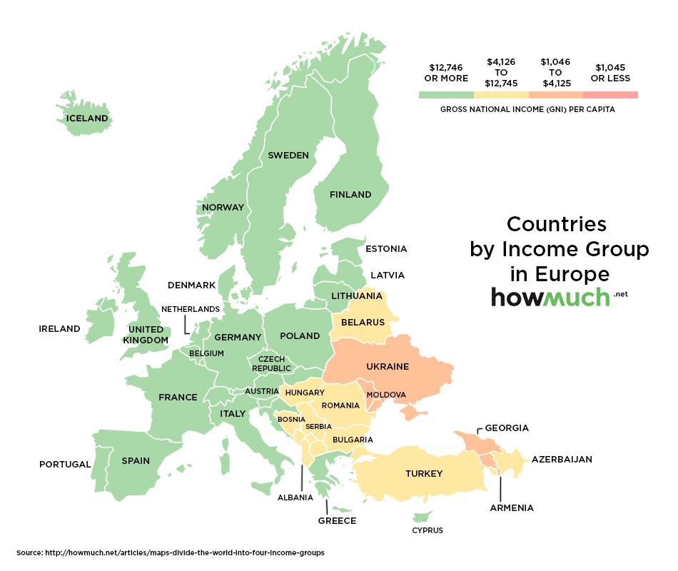
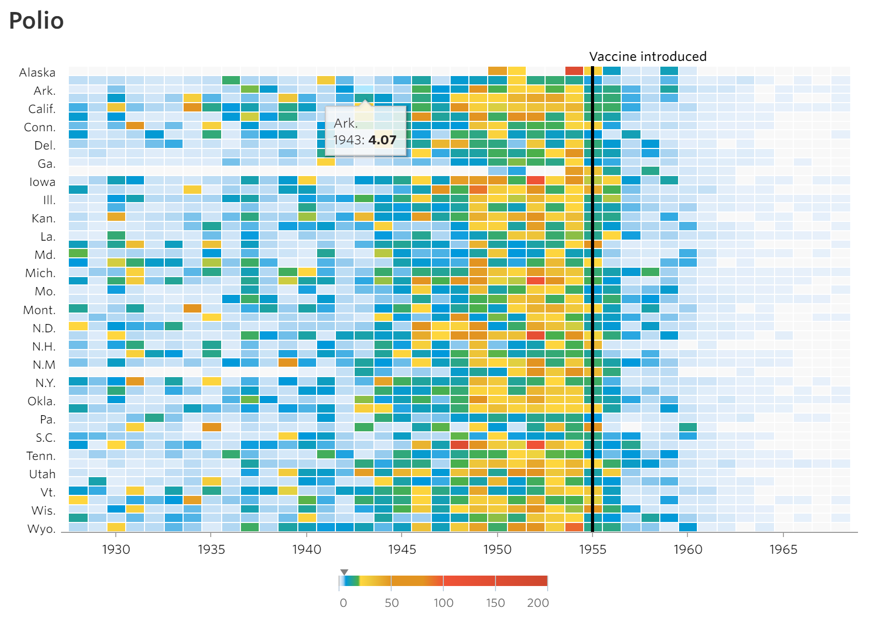
Data Visualization

Slide 24
Q&A
@msugvnua
Alex.Krakovetskiy@devrain.com
http://devrain.com

